Slide 1
IPL MATCH OUTCOME PREDICTION USING DEEP LEARNING AND MERN STACK
- By Team G153

Slide 2
01 ABSTRACT
Cricket is India’s most popular sport, played across various formats such as T20, ODI, and Test matches. Among these, the Indian Premier League (IPL) stands out as a high-profile, fast-paced T20 tournament that draws players from regional, national, and international teams. Its widespread popularity is fueled by live streaming, radio commentary, and TV broadcasts, capturing the attention of millions of cricket fans worldwide. Predicting the outcome of IPL matches is crucial for online traders, sponsors, and fantasy league enthusiasts. Our Study reveals that, despite the robustness of deep learning approaches, models, achieving an impressive accuracy of 83.10%, showcasing the potential of ML/DL techniques in sports analytics.

Slide 3
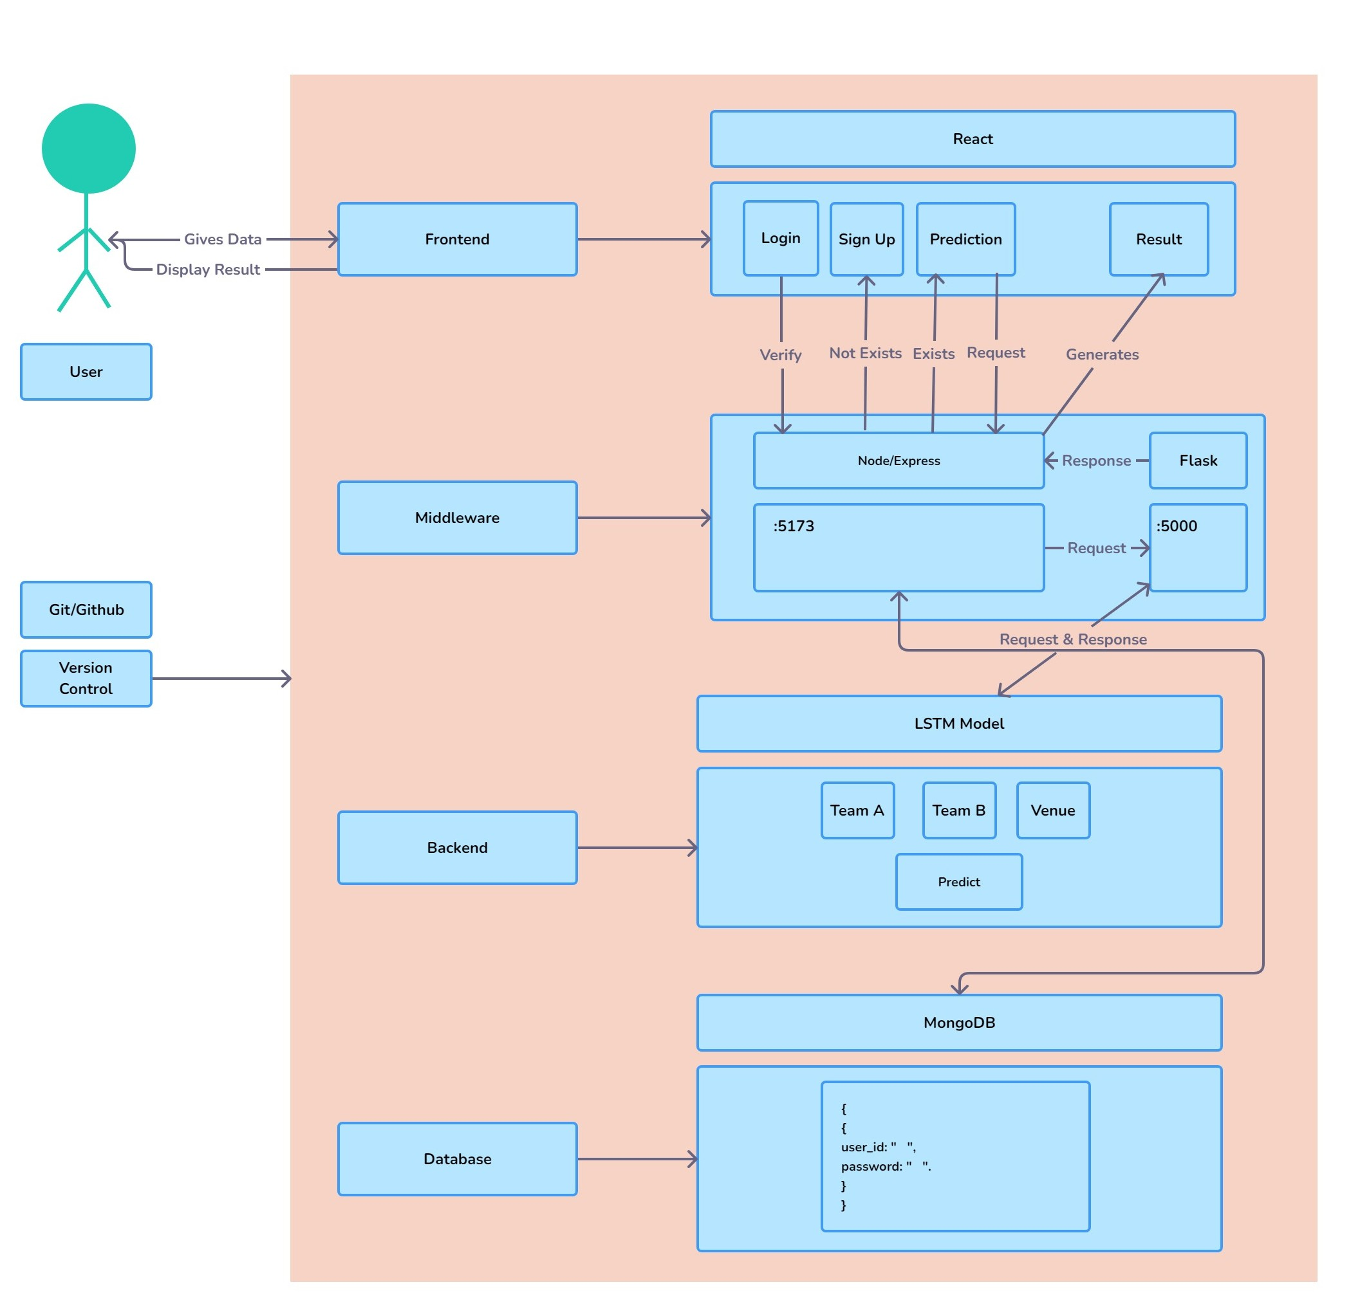
02 ARCHITECTURE

Slide 4

03 TECHNOLOGIES USED
Frontend: React, Bootstrap
Middleware: Node.js, Express.js, Flask
Deep Learning: LSTM (Long Short-Term Memory) through Python TensorFlow
Database: Mongo DB
APIs: Fetch(for frontend-backend communication)

Slide 5
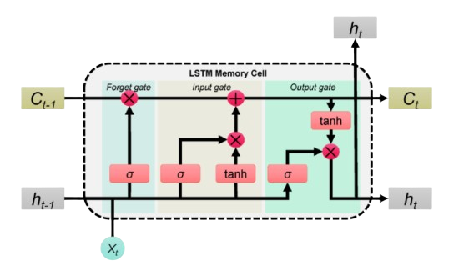
04 LSTM MODEL
Our Website employs an LSTM model , a type of neural network, to predict match outcomes using historical data. The model processes important input features, like batting team, bowling team, and venue, which are encoded using OneHotEncoder to handle categorical variables. Additionally, features like over and ball, representing the progression of the match, are scaled using StandardScaler to normalize the values. The LSTM model is designed to capture sequential dependencies, which is essential for understanding the dynamic nature of cricket matches. Users receive forecasts for team scores, run rates, and wickets through an interactive interface, enabling accurate predictions for upcoming IPL matches.

Slide 6

05 FUTURE ENHANCEMENTS
Future Enhancements for the IPL Prediction Website
Mobile App Extension
A mobile app using React Native will provide users with easy access to predictions and match updates on Android and iOS, enhancing the user experience with on-the-go functionality.
Over and Ball-Specific Score Prediction Users can view predicted scores for specific overs and balls, offering real-time insights and tracking match momentum.
Player-Specific Impact Analysis The system will analyze player stats like batting averages and strike rates to improve prediction accuracy using advanced machine learning based on player performance history.

Slide 7

Thank you!

